Slide 1


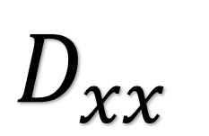

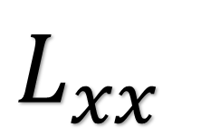
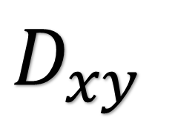
+1
-1
+1
-2
-2
+1
+1
-1
+1
+1
$$D_{xx}$$
$$D_{yy}$$
$$D_{xy}$$
$$L_{xx}$$
$$L_{yy}$$
$$L_{xy}$$

